Slide 1
Case Study: Amazon’s AI Recruiting Tool
Reducing Bias in Automated Resume Review System
Team 4:Victoria Adofoli, Kristian Koeser,
Ruthwik Kuppachi, Sagar Chand

Slide 2
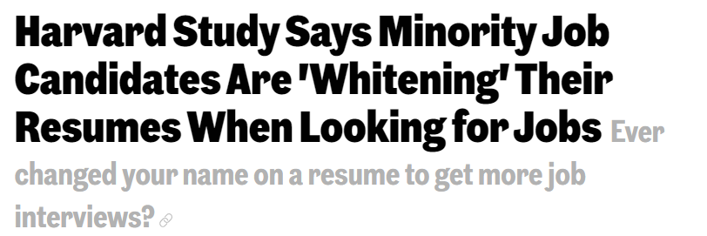
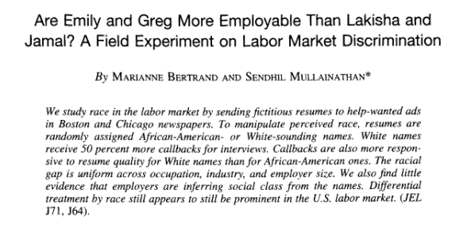
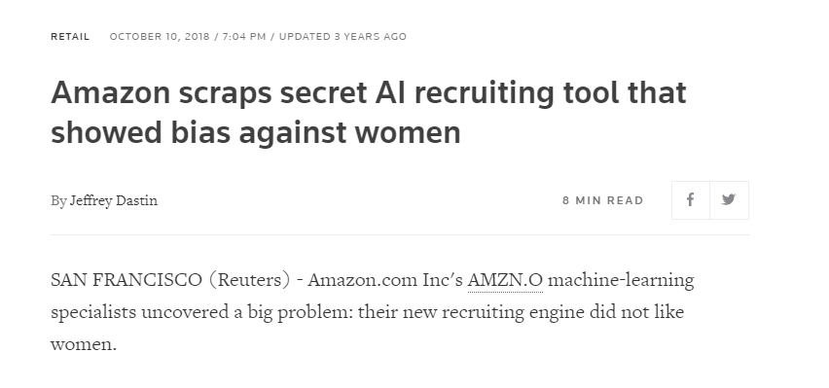
Our Inspiration
Notes:
Fellows at the National Bureau of Economic Research conducted an experiment, a resume bias study, between July 2001 and January 2002, reveals many aspects of discrimination from employers.
In the experiment, they responded to more than 1,300 employment ads for, administrative support, clerical, and customer services job categories, sending out nearly 5,000 fake resumes. The resumes are randomly assigned African-American names like Emily and Greg- or White-sounding names like LaKisha and Jamal. They found that White names receive 50 percent more callbacks for interviews. Callbacks are also more responsive to resume quality for White names than for African-American ones. Equal Opportunity Employers discriminated as much as other employers. If the fictitious resume indicates that the applicant lives in a wealthier, or more educated, or more-white neighborhood, the callback rate rise.
We read about a Harvard study in 2017 which revealed that that applicants that white washed their resume received more call backs. Twenty-five percent of black candidates received callbacks from their whitened resumes, while among Asians, 21 percent got calls if they used whitened resumes, even though the qualifications listed were identical.
We wondered if this problem was still a prevalent issue if AI resume tool was involved and our study showed us that it was. We came across 2018 Amazon scandal which their AI resume and recruiting tool discriminated against women and mid-career applicants. We’ll discuss the Amazon case study more in depth in later slides.

Slide 3
Research Questions
Main question: How do we make an AI recruiting engine less biased and more inclusive of diverse applicants ?
Secondary questions:
How does AI-based screening work in various settings? What are the various tools being used in large tech companies?
What biases exist and where do biases come from?
What are some of the main methods to reduce biases in this particular setting?
Notes:
So our group was curious about how do we make AI recruiting engine less biased and more inclusive of diverse applicants?
Our secondary questions include:
How does AI-based screening work in various settings? What are the various tools being used in large tech companies?
What biases exist and where do biases come from?
What are some of the main methods or best practices to reduce biases in Amazon’s AI resume system?

Slide 4
What is an AI Recruiting Engine/ Resume Review System
Definition:
It is the application of artificial intelligence to the talent acquisition process,where machine learning can learn to shortlist your ideal candidate, as well as automate manual tasks in the recruitment process.
Involves algorithms and past/current datasets
Looks for keywords and profiles that fit into current employee pool
Reviews applicant’s profile, skills and experiences
Notes:
What is an AI recruiting engine?
It is the application of artificial intelligence to the talent acquisition process,where machine learning can learn to shortlist your ideal candidate, as well as automate manual tasks in the recruitment process.
The AI tool will produce a set of rules (algorithms) that attempt to use past data (resume data from old and current employees to predict future applicant performance.
AI will have a set of instructions to look through the past/current resumes in your dataset
It will look for keywords and profile potential applicants that fit the mode or the current employee pool (so if your company happens to attract white male, the AI will continue the process)
So AI recruiting tool would allow candidates to create their profiles and conducts assessment of their skills and experiences

Slide 5
AI Recruiting Tools: Use & Benefits
55 percent of U.S. HR Managers use AI recruiting tool in their work
Popular AI-powered platforms are HireVue, Workday, Unilever, Vodafone
Tool may include features such as candidate discovery, candidate relationship management and assessment, and job market forecasting analysis
Benefits
Makes HR more strategic and less operational
Less costly and time consuming than traditional in-person recruitment
Harness data to create a deeper intelligence of each candidate
Bring objectivity to a previously subjective process
Notes:
AI recruiting tool is becoming increasingly popular.
Global AI recruiting market is expected to reach a staggering market value by 2025 as it offers advanced applications for recruitment process such as recruiter chatbox, intelligent screening and digitized interviews. It increases the quality and efficiency of the recruitment process.
Employers have long dreamed of harnessing technology to widen the hiring net and reduce reliance on subjective opinions of human recruiters.
55 percent of U.S. human resources managers said artificial intelligence (AI) would be a regular part of their work within the next five years
HireVue is arguably the best-known AI-powered hiring platform, deployed by 700+ companies, including Workday, Unilever, Vodafone, PwC, and Oracle
Features such as candidate discovery, candidate relationship management and assessment, and job market forecasting analysis
Benefits
HR to make better informed decisions, to be more strategy and less operational (reducing administrative tasks)
Many companies use AI to automate the screening stage in the hiring pipelines in hope of hiring quality candidates because it is less costly and time consuming.
Believed to accurately test candidates’ skills and behaviors in real situations, generating an incredibly smarter database for making hiring decisions,
Harness data from your internal database, job boards, social sites, and 50+ other relevant professional sources to create meaningful insights and a deeper intelligence of each candidate.
Bring objectivity to a previously subjective process by relying on relevant candidate and industry data, trends, and insight to make hiring decisions.

Slide 6
Broad Challenges with AI Recruiting Tools
Lack of diversity in developers
Homogeneous database (male, white, middle-class/upper class)
Limits the applicant pool for a specific audience
Historically biased data used to train the AI model
Machine heavy than human centric (no relationship building)
May be unreliable at times
Notes:
AI, which is expected to reduce bias related to name, age, gender, nationality, etc. in the recruitment process, may unknowingly introduce bias in the system itself. This happens because AI recruiting tools analyze patterns. Now, if you feed in your company’s last five years’ recruitment data into an AI-powered tool, it will learn from the database. It will pick up any pattern that was present earlier.
AI resume tools several challenges
The lack of diverse designers can allow the product to retain pernicious or selective or biased features. Majority of the developers are white males. Perhaps developers from diverse demographics may be in a better position to ask questions about sources of data and flag something they don't think is representative
Use of historically biased data set to train the AI model
Machine heavy than human centric ---Lack of Human Touch. Lacks the relationship building aspects of the recruiting process with the candidate. An Automated recruiting system is only looking for key words and misses out on the interesting details of a candidate. It lacks emotional or reasoning. It is important to have a human-centric platform that is efficient while also ensuring that candidates are recognized as individuals with unique personal career ambitions and achievements to share.
Reliability Still a Matter of Concern - data learning may have numerous inconsistencies and flaws. The data made available to these tools is not enough many a time. They need a plethora of data to recognize patterns and derive conclusions.
For instance, an applicant screening system may reject a candidate profile simply because he or she doesn’t meet the exact requirements as mentioned in the JD. The applicant might have used a different font in the resume, or the scanner wasn’t able to read it properly.
Some of the problems include the following: losing qualified candidates (especially from non-traditional backgrounds, and recent college graduates, borderline candidates or those switching careers will be at a disadvantage ), inadvertent privacy violations that reinforces social biases of race, gender, sexuality, and ethnicity

Slide 7
Common Types of Biases
Similarity Bias
Halo Effect
Illusory Correlation
Negative Emphasis Bias
Notes:
Halo effect is when the recruiting system tends to focus only on one positive aspect like the school they attended and ignores the rest.
Negative Emphasis bias is the complete opposite of the halo effect. It is when the AI system emphasizes only one negative aspect of the applicant like their GPA and ignores the rest.
Similarity bias is when the system tends to give a preference to candidates that have very similar characteristics to the people whose resumes were used to build the system.
Illusory correlation is when the system believes that there is a relationship between two variables even when there is no such relationship.

Slide 8
How does AI-based screening work in various settings?
Key Common Factors
Anonymizes demographic data/Masks candidates
Screening resume keywords and potential candidate characteristics
Interactive AI chat box used to gather further data and characteristics
Candidate progression and ranking optimized by having HR platforms interact with AI screening process
Unique Processes
Applicant characteristic and interactive data acquired through monitoring and analyzing applicant’s interactions and action on the application portal
Includes coding challenges/tests for analyzing candidate’s problem solving abilities and tendencies
Speech pattern, word choices, and facial pattern analyzed during interview using augmented intelligence

Slide 9
CASE STUDY:
AMAZON RECRUITING/ RESUME REVIEW SYSTEM

Slide 10

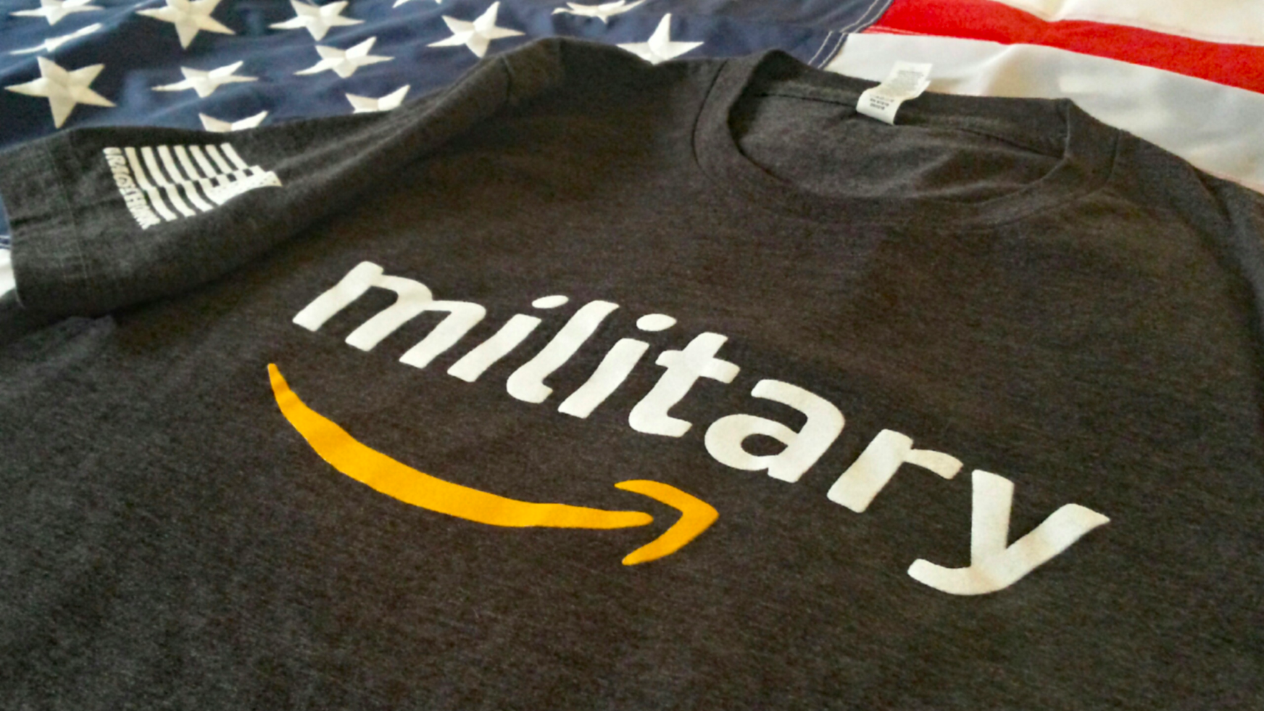
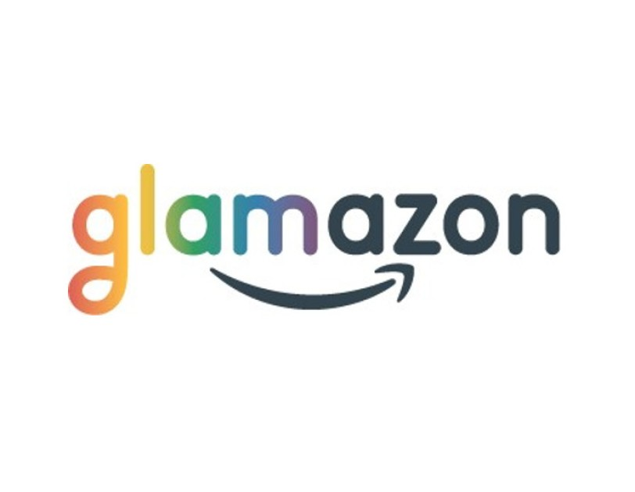
Amazon’s Programs on Diversity and Inclusion
Glamazon - LGBTQ+ community
Warriors@Amazon - Veterans and Military Spouses
Women@Amazon
And many more affinity groups for other diverse groups
Notes:
Amazon has 13 affinity groups that aim to bring employees, community members, and other stakeholders belonging to various demographic groups together. These affinity groups advise the business units at Amazon, work on service projects, and interact with the local community. Some of the most popular groups include Glamazon, a group that educates and informs employees and other people about the LGBTQ community, Women@Amazon, the largest affinity group at Amazon, and Warriors@Amazon, that aims to help veterans transition into civilian life and provide opportunities for military spouses.

Slide 11
Amazon’s Discriminatory AI Recruiting System
How It Was Created & How It Works
Built in Edinburgh, Scotland (home to Amazon Development Center)
Designed to recognize 50,000 key terms that showed up on past candidates’ resumes
Vets patterns in resumes submitted to the company over a 10-year period
Required to have basic programming skills
Favored verbs more commonly found on male engineers’ resumes, such as “executed” and “captured
Provide recommendations to the recruiters about top candidates
Bias Against
Woman applicants
Mid-career transition applicants
Non-traditional applicants (no CS background)
Notes:
Amazon’s original Intent to develop AI that could rapidly crawl the web and spot candidates worth recruiting.The company was trying out this system to shortlist candidates automatically for certain unfilled positions. The team in Edinburgh, Scotland working on the tool found out that the tool was biased against female candidates because the previous 10 years’ data fed into the system had a pattern of subconscious/unconscious bias against females. The algorithm had no idea it was supposed to ignore it.
How it was built:
Amazon team in Edinburgh, Scotland (which is home to Amazon Development Center) created 500 computer models focused on specific job functions and locations. They taught each to recognize some 50,000 terms that showed up on past candidates’ resumes.
Amazon’s computer models were trained to vet applicants by observing patterns in resumes submitted to the company over a 10-year period.
The algorithms learned to assign little significance to skills that were common across IT applicants, such as the ability to write various computer code (programming is an expect skillset)
Most came from men, a reflection of male dominance across the tech industry. Favored verbs more commonly found on male engineers’ resumes, such as “executed” and “captured,
Amazon’s recruiters looked at the recommendations generated by the recruiting engine when searching for new hires
Bias
It’s recruiting engine penalized resumes including the word “women’s” until the company discovered the problem. For instance, it penalized resumes that included the word “women’s,” as in “women’s chess club captain.” And it downgraded graduates of two all-women’s colleges. Essentially the system taught itself to prefer male applicants
It was also found to be baised against applicants from nontraditional backgrounds (those in career transitions, no computer system backgrounds)
So we looked at Amazon’s top competitors to see how they were doing in diversity.

Slide 12
Project Goals: An Improved Amazon AI Resume Tool
Stages of hiring process: sourcing, screening, interviewing, and selection
Short term goal: Reduce bias in Amazon’s AI resume review system
Long term goal: To create and retain an inclusive AI resume review system that does not discriminate against any particular group of people; develop a successful scheme that could promote diversity in Fortune 500 companies.
Notes:
Into: Broadly speaking, there are four stages in the hiring p­rocess: sourcing, screening, interviewing, and selection. The screening stage involves evaluating applicants— offering the “best” candidates for the company. Algorithmic screening is the most active area of development and often the most consequential, as it represents the major filter through which applicants increasingly must pass. As a result, we aim to improve the AI resume screening process.
Short term goal: To improve Amazon’s AI resume review system
Long term goal: To retrain and create a more inclusive AI resume review system that does not discriminate against any particular group of people.
And develop a successful scheme that could promote diversity in Fortune 500 companies.

Slide 13
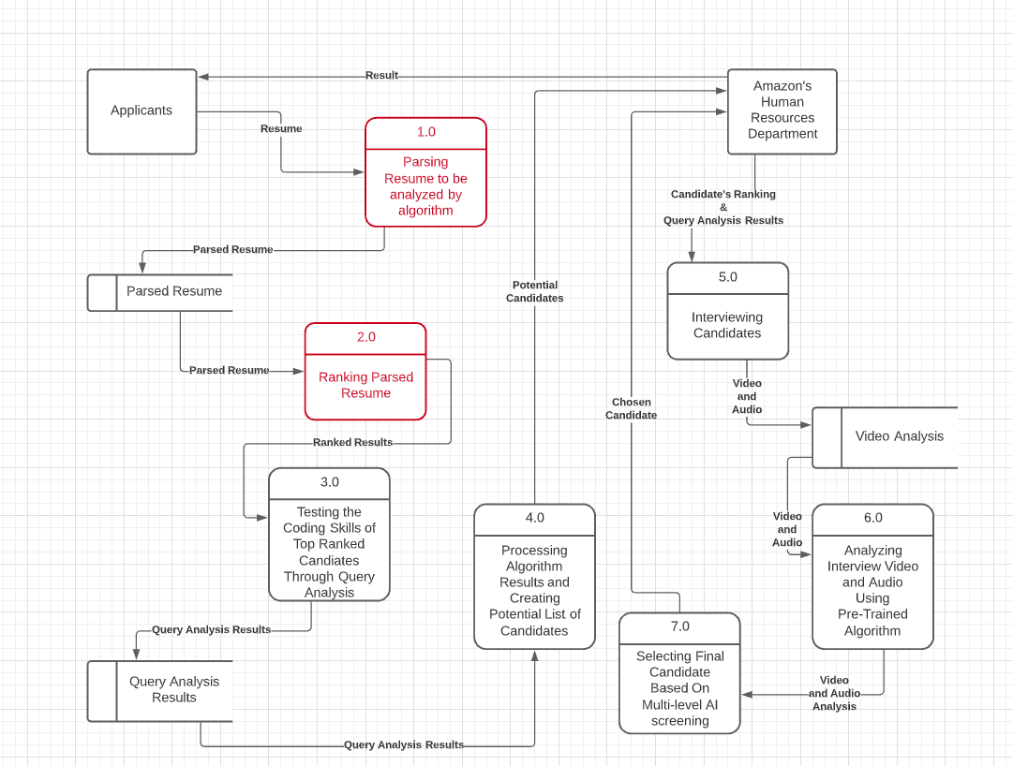
Amazon’s DFD
Notes:
Based on the information we have gathered, we were able to create a DFD of Amazon’s recruiting process.
Our focused attention will be on 1.0 “Parsing resume to be analyzed by the algorithm” through 2.0 “ Ranking the candidates”

Slide 14
Amazon’s Competitors
Retail store rivals: Target, Walmart, Best Buy, and Costco
Subscription services: Netflix, Apple, and Google
Web services: Oracle, Microsoft, and IBM
Notes:
List of Amazon top’s competitors
In terms of retail store rivals: Target, Walmart, Best Buy, and Costco
In terms of subscription services: ,Netflix Apple, and Google
In terms of web services: Oracle, Microsoft, and IBM
We highlighted Target, Walmart, Netflx, and MS because they are listed as companies with high diversity numbers and best places to work for people of color according to DiversityInc, Fortune 500, and Forbes 2021. These companies, with the exception of Amazon, have internationally invested resources to maximize their DEI efforts.

Slide 15
Comparison Table: Amazon vs Others
(DiversityInc, Fortune 500, Forbes 2021)
Companies | Employees | Diversity Ranking 2020 | Diversity Numbers 2019-2021 | Leadership 2019-2021 | DEI Goals
Amazon | 1.3 million | N/A | Women 31.4% Black 7.2% White 47% | Managers 73% men 28% women 8.3% black 60% White . | By 2021, Double the number of Black directors and vice presidents By 2021, Increase the number of women in senior technical jobs by 30%
Microsoft | 181,000+ | #1 | Women 28.6% Black 4.9% 7.0% Latino/Hispanic 35.4% Asian 2.5% Multiracial 7.1% disabled | Women 20% Hispanic 6.0% of managers, 5.2% of directors, and 5.2% executives. Black 3.9% of managers, 3.2% of directors, and 3.8% of executives Asian 31.0% of managers, 31.3% of directors, and 26.2% of partners + executives. | In 2021-22, invest $150 million on diversity and inclusion programs By 2025 Double its number of Black and African American managers and senior employees
Notes:
The Diversity numbers at amazon is debatable but it is very likely that the percentage of women were probably much lower than 31 percent in 2018

Slide 16
Companies | Employees | Diversity Ranking 2020 | Diversity Numbers 2019-2021 | Leadership 2019-2021 | DEI Goals
Target | 355,000+ | #3 | 49% white 26% Hispanic/Latino, 15%Black 5% Asian 58% women 42% male | No. 7, Top Companies for Women of Color 50% women 25% people of color No. 4, Top Companies for Board of Directors of which ⅓ are women and nearly ½ are Latinx or Black. | Racial Equity Action and Change committee By 2023, to increase Black representation across the company by 20%
Walmart | 2.2 million+ | #20 | 57 women 37% people of color No. 6, Top Companies for LGBTQ Companies for Talent Acquisition for Women of Color No. 14, Top Companies for Veterans | Women 24 percent Board Members 28 % corporate officers 43 % in management Black No. 10, Top Companies for Black Executives 12% of the company’s managers and 7% of its officers are Black. Asian No. 13, Top Companies for Asian American Executives | By 2026, contribute $100 million to boost diversity Invest in more diverse and minority suppliers
Netflix Advertising & Marketing | 9,400 | #27 | Women 47.9% Men 43.8% Black 10.4%, Hispanic 8.5% Asian 23.8%, White 42.9% | Women: 47.4%, Men 45.2% Two or More Races 4.9% Black 13.3%, Hispanic 4.9% Asian 16.3% White 54.4% | 15 ERGs serving Latinx, veteran, Black, and disability communities

Slide 17
SOLUTIONS
Notes:
We would like to create a system that has bias-free content and application experiences, as well as flexible communication options and candidate support candidates throughout the process

Slide 18
Settings, Utility, and Functionality
Setting: Professional Hiring Platforms
Item: Amazon’s AI Recruiting & Resume Tool
Functions and Utilities “Solutions”:
Phase I: A balanced datasets with diverse candidates
Phase II: Quickly analyse resume and minimum unconscious bias (Masked Recruiting)
Phase III: Develop a point based system and rank DEI values and other important metrics
Notes:
Setting: Professional Hiring Platforms
Item: Amazon’s AI Recruiting & Resume Tool
Functions and Utilities:
Having a balanced datasets with diverse candidates (can be used by developers to develop better rules or algorithms for a fair process for future candidates)
A diverse dataset is only possible by sourcing candidates from diverse platforms (and applying traditional, human to human sourcing methods)
Quickly and efficiently analyse a prospective employee’s resume and minimum unconscious bias through a process called masked recruiting which hide personal information/ demographic status such as evidence of disability status, gender, race, age, ethnicity on the resume
Hold prospective employees to company standards and values, without including historical or institutional bias in the hiring decisions

Slide 19
Phase 1: Sourcing Methods: Diverse Pool of Applicants
Popular networking/job boards
Referrals
Campuses/meetups/conferences
Revisit previous applicants
Track all level of interaction
Partnerships: University of Maryland, University of California, Boston University, John Hopkins, Howard University, Virginia Tech, Columbia University
Notes:
The human element
Traditional way of HR post jobs and reach out to candidates on Linked, Google, and job boards,
Partnership with Asian alliance associations, veteran associations, historically black collegues, community centers
Campuses and meetup, social events and conferences (Big factor in MS/ Target/ and Walmart’s diversity)
Reach out to previous applicants and see if there is potential for your company
Keep track of contacts made (email, phone, in person)

Slide 20
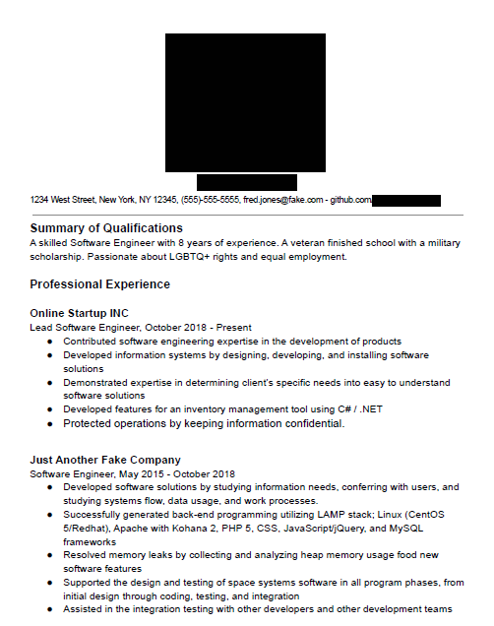
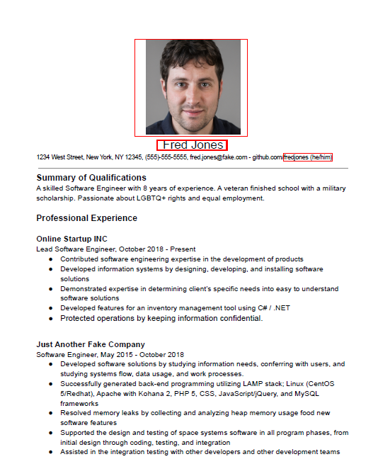
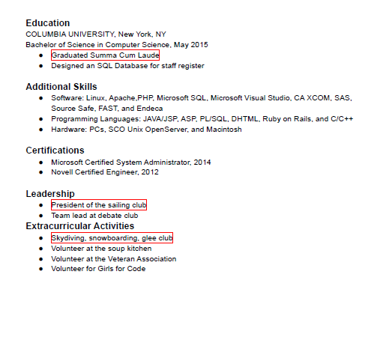
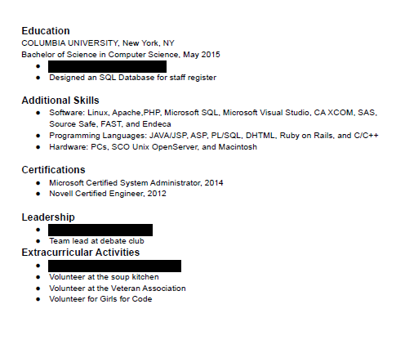
Phase II: Resume Parsing- Masked Recruiting Process
FRED JONES
Similarity Bias
Western ideas of white activities
Negative emphasis bias
Notes:
This is an example of Fred Jones. A typical white male with computer science background.
We see elements of similarity bias---> Ex: Under Leadership and Activities, you will sailing, snowboarding, and glee club ---> which may indicate some social bias of white male activities
An example of Negative emphasis bias is under Education -- fred graduated Summa Cum Ladee which means he has a very high GPA
On the other hand, there are some positive bias that reflects Amazon’s Diversity values and could benefit Fred in the long run and they are being a member of the LGBT community, a veteran and volunteers for girls for code,

Slide 21
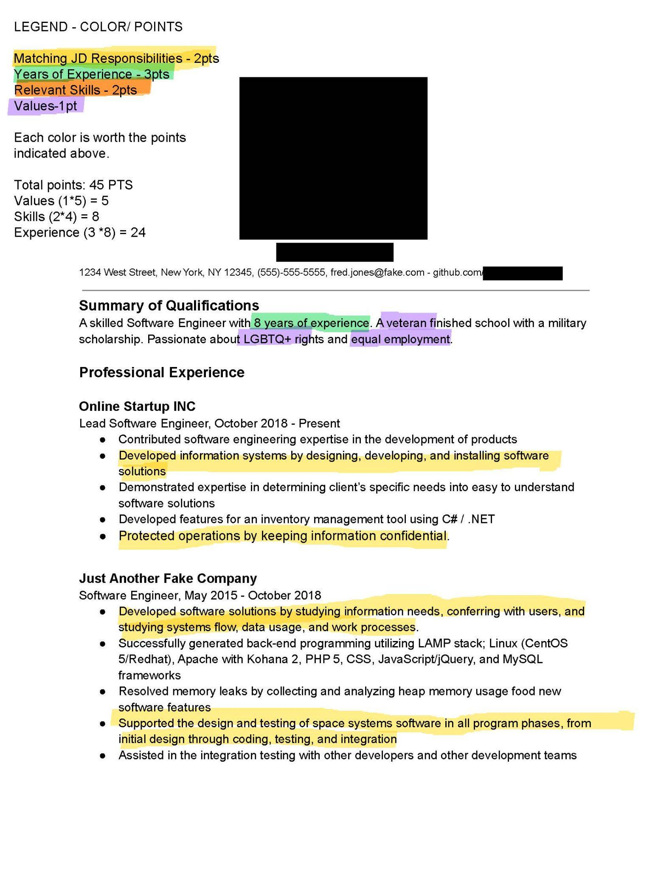
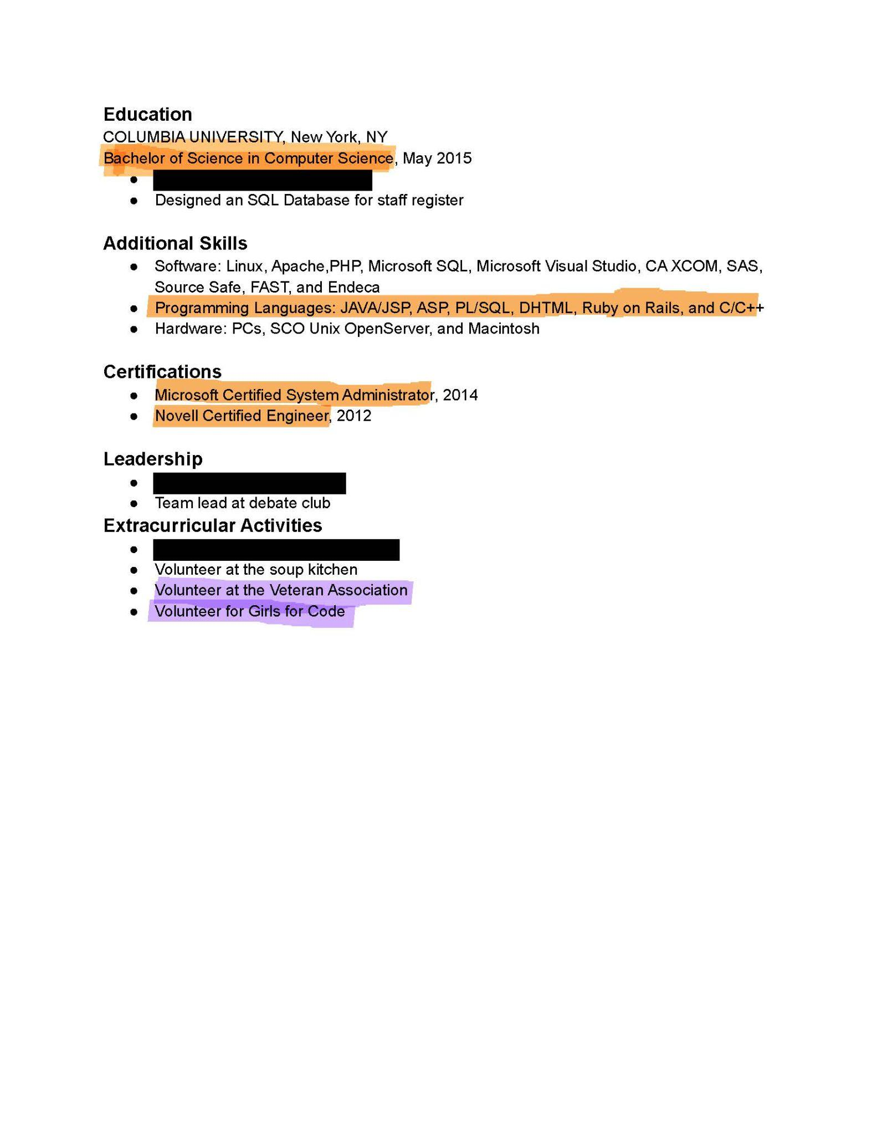
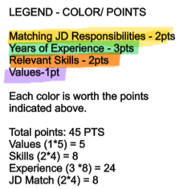
Phase II: Resume Parsing - Point System
FRED JONES
RESUME
45PTS
Notes:
This is the part two version of the resume parsing.
The masked recruiting removed the bias
And now the AI is entering a point system where it looks for keywords that match the job description and responsibilities, words that align with amazon’s diversity and inclusion values for veteran, women engineer, and so forth. It AI is also looking for relevant job skills and years of experience.
Each Job description is worth two points.. There are four highlighted job responsibilities so it’s 2pts * 4 = 8 points
Years of experience is worth 3 points… This person has 8 years of relevant experience so it’s 3 *8 = 24 points
Each highlighted skill is worth 2 points ...and There are four highlighted skills so it’s 2 * 4 = 8 points
Each highlighted diversity value is worth 1 points so it’s 3 points
The total number of points for this resume is 45 points.

Slide 22
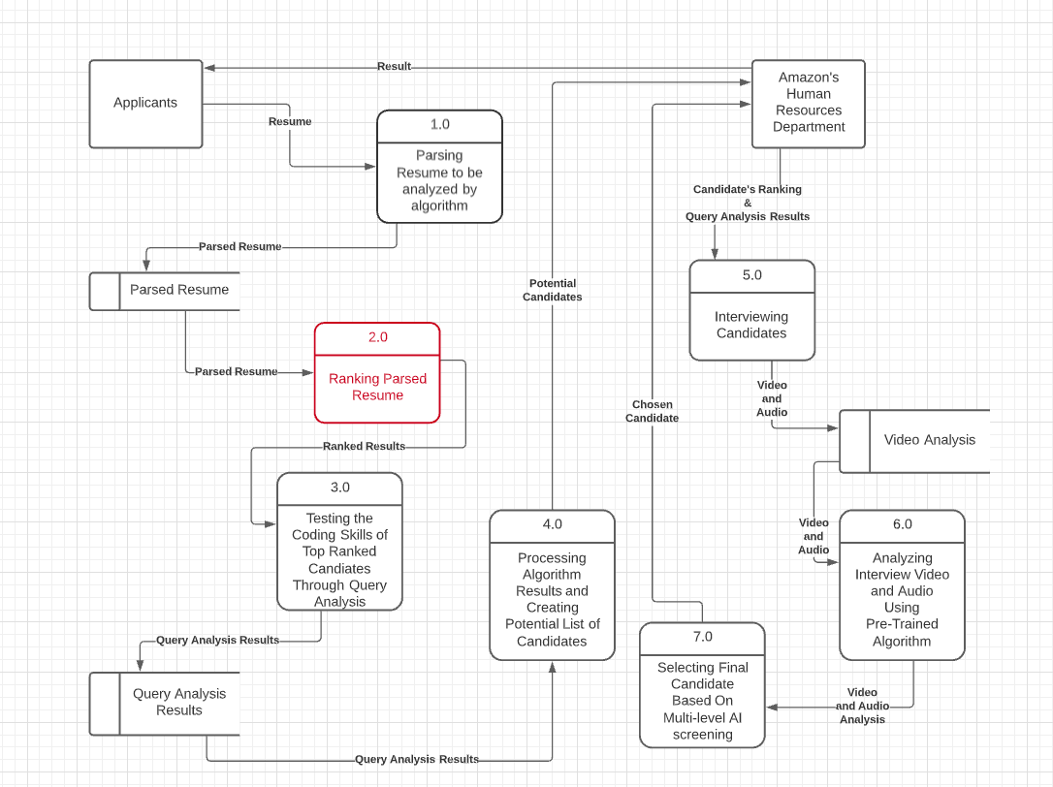

Slide 23
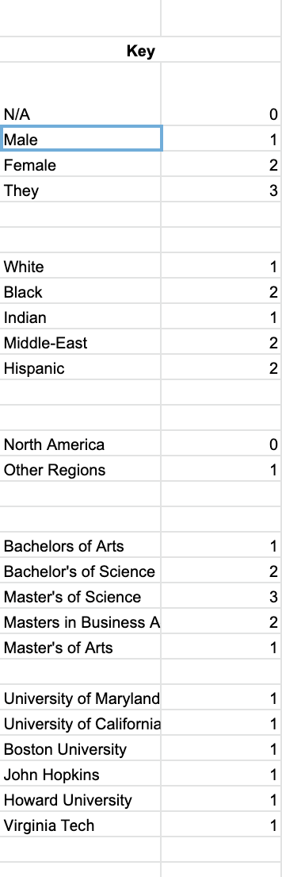
Phase III: Ranking Process
Phase II, Part 1 : Ranks from resume ranking
Phase III, Part 1: Taking into account diversity
Phase III, Part 2 : Taking into account education
Phase III, Part 3: Taking into account the number of interactions with Amazon
Notes:
kristian
Resume rank -- relevant skills, qualifications for job, # of years, Amazons DEI values
Diversity includes gender (how they identify themselves), ethnicity/race, region applied from, university affiliation (university of maryland, Columbia ,etc)
Education: degrees BS,BA, MS, MA,
# of interactions with Amazon -- includes referrals, in person (conferences, previous interview candidates), online connection

Slide 24
Fred Jones
Phase II Resume Parsing = 45 points
Phase III Rating Points: 5 points
Total Points = 50 points
Notes:
This shows the combined score from the application details and resume parsing.

Slide 25
Impact: How Our System Mitigates the Biases
Similarity Bias: Hiding irrelevant information about a candidate like the sport they played or the club they were president of (Phase II).
Halo Effect and Negative Emphasis Bias: Taking into consideration all relevant information on a resume instead of focusing on one particular aspect (Phase II).
Illusory Correlation: Redacting demographic information and image from a resume helps remove any bias-inducing variables that recruiters might use for hiring decisions (Phase II).
Notes:
How we mitigate biases and reduced AI Recruitment Challenges (SCROLL DOWN TO SEE MORE NOTES)
Similarity Bias
Confirmation Bias
Halo Effect
Illusory Correlation
Negative Emphasis Bias
Phase I & Phase II human elements is integrated with machine learning) - meaning that we used traditional recruiting methods (ex: referrals, college recruiting, conferences) and human interactions in order to build a diverse database/dataset
Solved the problem of …
Historically biased data ---> Limited applicant pool (White, male, middle upper class)
Diverse pool of applicants instead of a homogenous pool . We reward diversity but creating a ranking point system (region of the world, gender, race, affiliated university)
Phase II - Resume Parsing, reduced bias by filtering out imporant things on the resume
Solved it by
Point system for things relevant to the job description and to Amazon’s core values -- military, female engineers, ect
Mask recuiting

Slide 26
Practical Applications & Recommended Policy Actions
Options with the degree of affirmative action utilized by the AI program:
Completely blind (solely relevant skills)
Selective diversity factor prioritization
Aggressive form of affirmative action
Notes:
There is no one size fits all for reducing bias and increasing diversity in a company, especially through an AI recruiting system.
These are policy recommendations that can be tailored to a company’s specific diversity goals.
Company could decide to do …
Blind Auction
Utilize masked recruiting which removes every personable identifiable information (IPP) from a person’s resume and just focus solely on relevant skills of the candidate for the job. Doing this could be good enough for a company where diversity may not necessarily be a big issue
Selective diversity factor prioritization
Which includes some form of affirmative action to some degree if they company needs a little help with its diversity efforts. It may mean valuing certain diversity over others which may be relevant to the mission of the organization. For instance, if you are a organization that serves veterans, it is possible that the company wants to have staff that majority consists of veterans. If you are a nonprofit organization serving a particular community, it may be in the company's best interest to have selective diversity metric where the staff represents the community that is being served
Lastly is the most aggressive form of affirmative action which we applied in our solution.
Our application/strategy was an example of aggressive diversity, equity and inclusion efforts into the AI system for Amazon. Which we valued-based point system which ranked diversity (gender, race, region, and affiliated university)

Slide 27
Limitations of Reducing Bias
Positive Bias
Lack of diverse dataset
Changing work culture mindset
Prejudice, stereotypes, unconscious bias
Notes:
Companies who take aggressive efforts into diversity and recruiting have to consider personal identifiable information, they take into account certain bias that affect people. This could be a positive bias. For instance, a company can take into account more females than males as a positive factor because the company is looking for more female engineers. The limitation is that it is still bias. Bias is still implicated.
Lack of diverse dataset
Prejudice, stereotypes, unconscious bias is still a societal issue. It may be hard to change a company work culture if people do not feel valued. It’s not enough to just hire people of color. It is important to have an inviting and supportive work culture for them to stay in the company. Improving diversity is a multifaceted process.

Slide 28
Best Practices for Companies
Build a datasets with diverse candidates (Sourcing)
Masked Recruiting (Screening)
Increased transparency (Screening & Selection - Explainable AI)
Auditing the performance data that is being used to train the model (Screening)
Measure your results and track diversity efforts (Screening)
Notes:
In order to build a fair AI resume recruiting tool and a diverse pipeline of for your company, it is important to...
Build a datasets with diverse candidates. Using sourcing tools to seek out people from diverse backgrounds to build a pipeline of diverse candidates. Allows company to build a diverse dataset and have a diverse selection of candidates
Increase transparency with applicants about how decisions are made
For example, Explainable/interpretable machine learning, gives users a way to vet how an algorithm arrived at its recommendation, such as why it selected certain candidates for interviews,
Masked recruiting: hide personal information such as evidence of gender and ethnicity on the resume
Auditing the performance data that is being used to train the model. Companies can actively look for any bias in the input that can lead to a biased output.
Carefully test for the presence of adverse impact in the predictions of the model.
Measure your results -- Track efforts with diversity survey and reports, using demographic data and diversity metrics to adjust your DEI strategy

Slide 29
THANK YOU

